Slide 1
Formula 1 Optimization
Kirtan Patel, Rohit Shah, Landon Yamanaka, Keegan Barbee

Slide 2

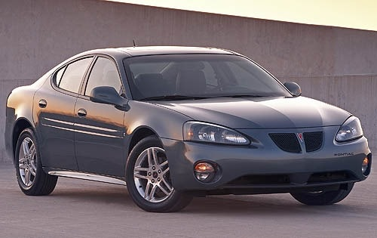
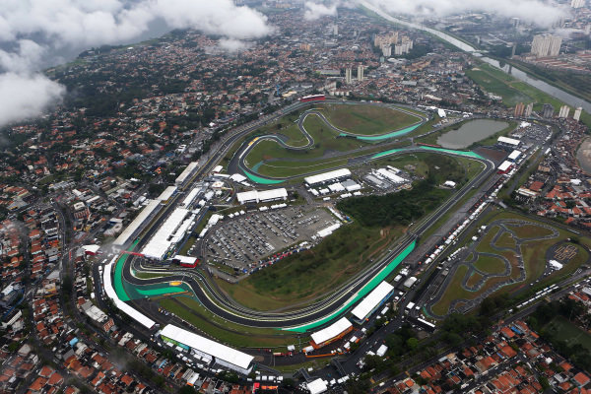
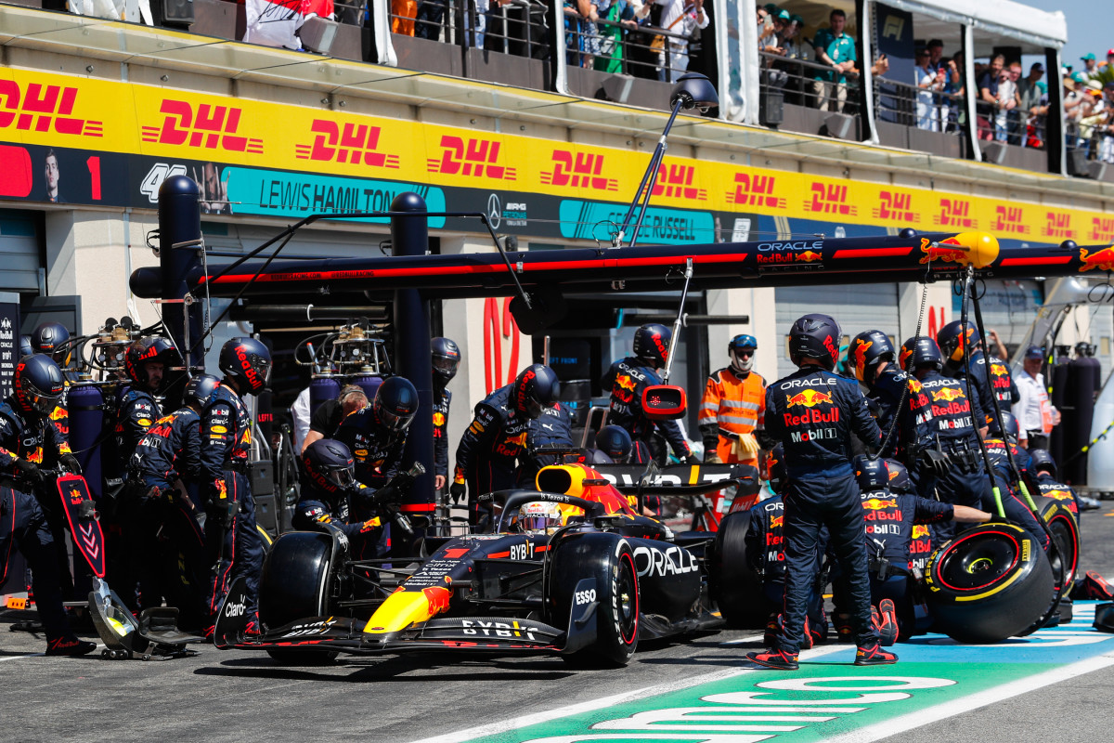
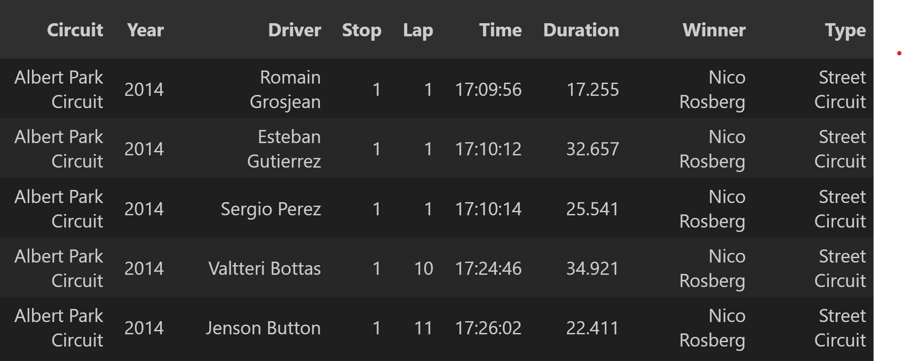
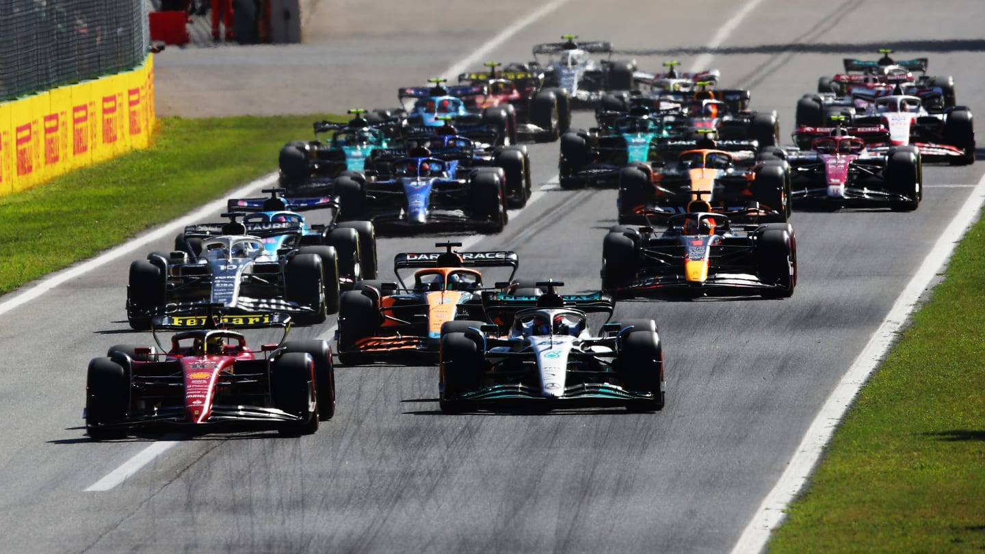
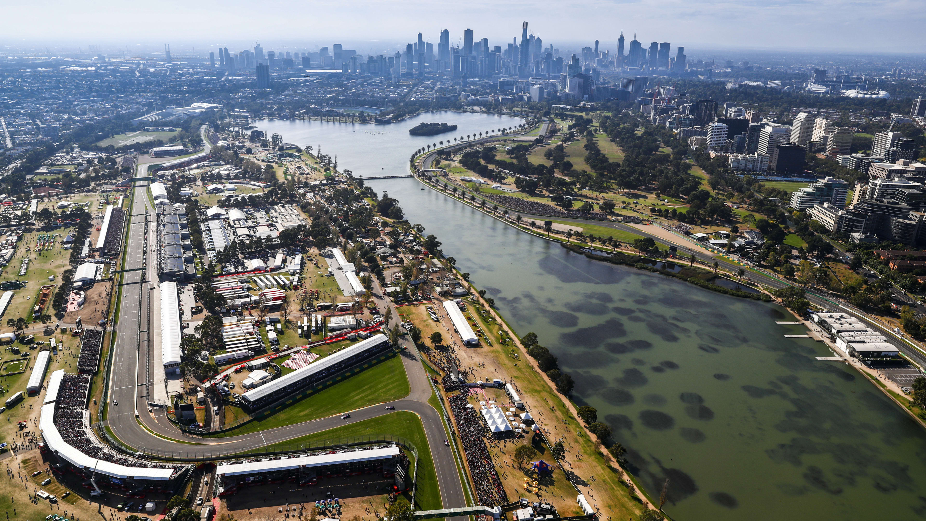
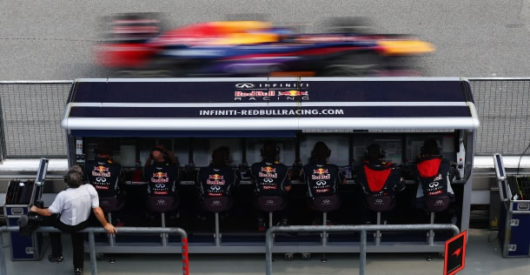
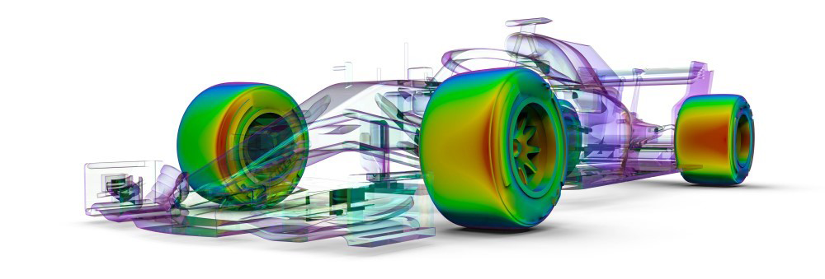
Formula 1 Overview
Series of Grand Prix’s | Different Tracks & Shapes | Many Factors Influence a Race | Explored the Influence on Tyre & Pit Stop Strategy
Notes:
4 pics with the word under it

Slide 3
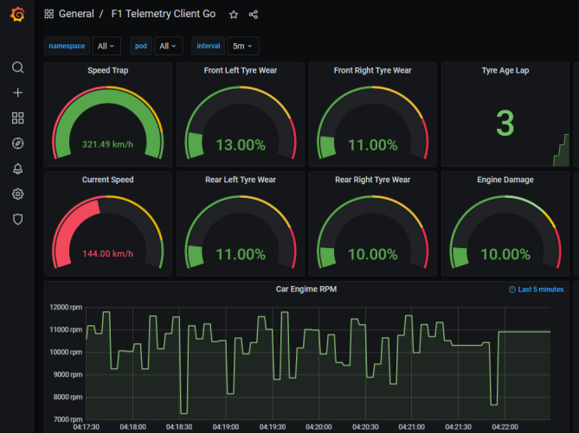
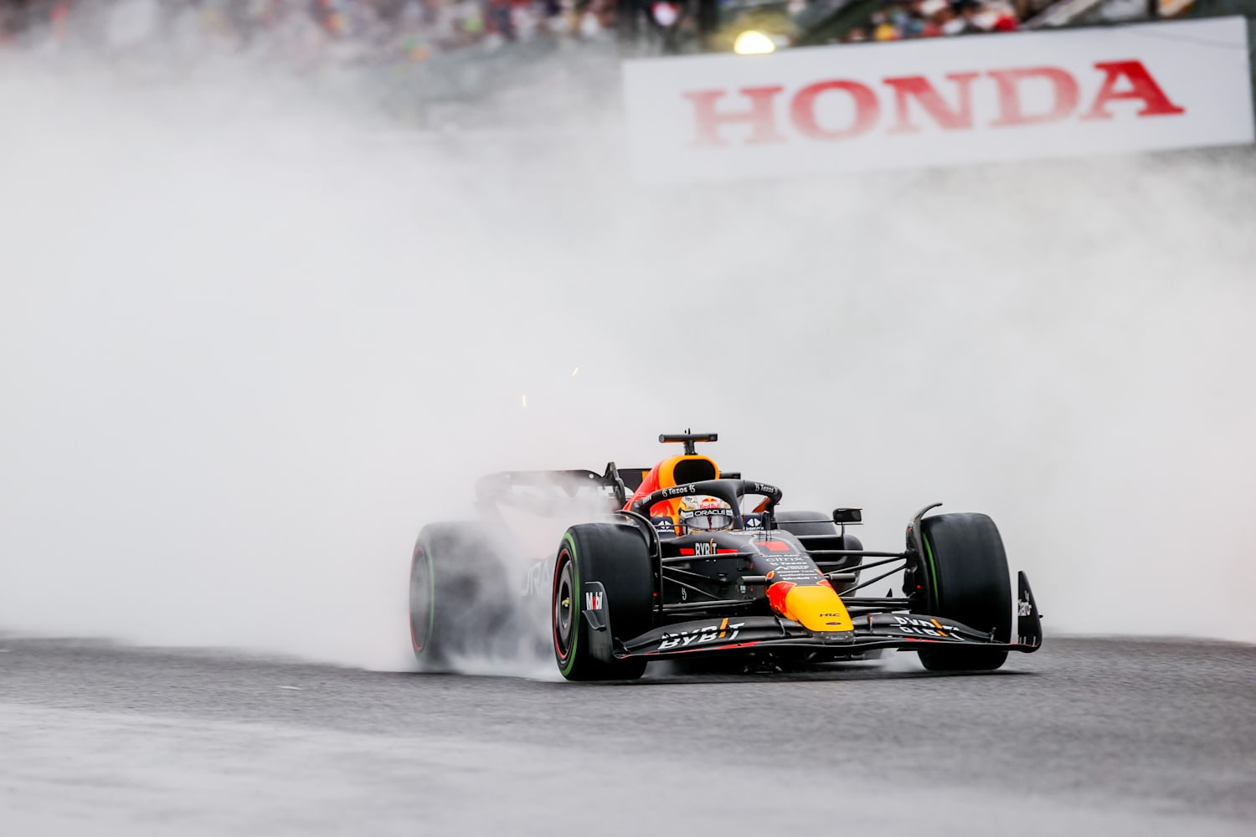
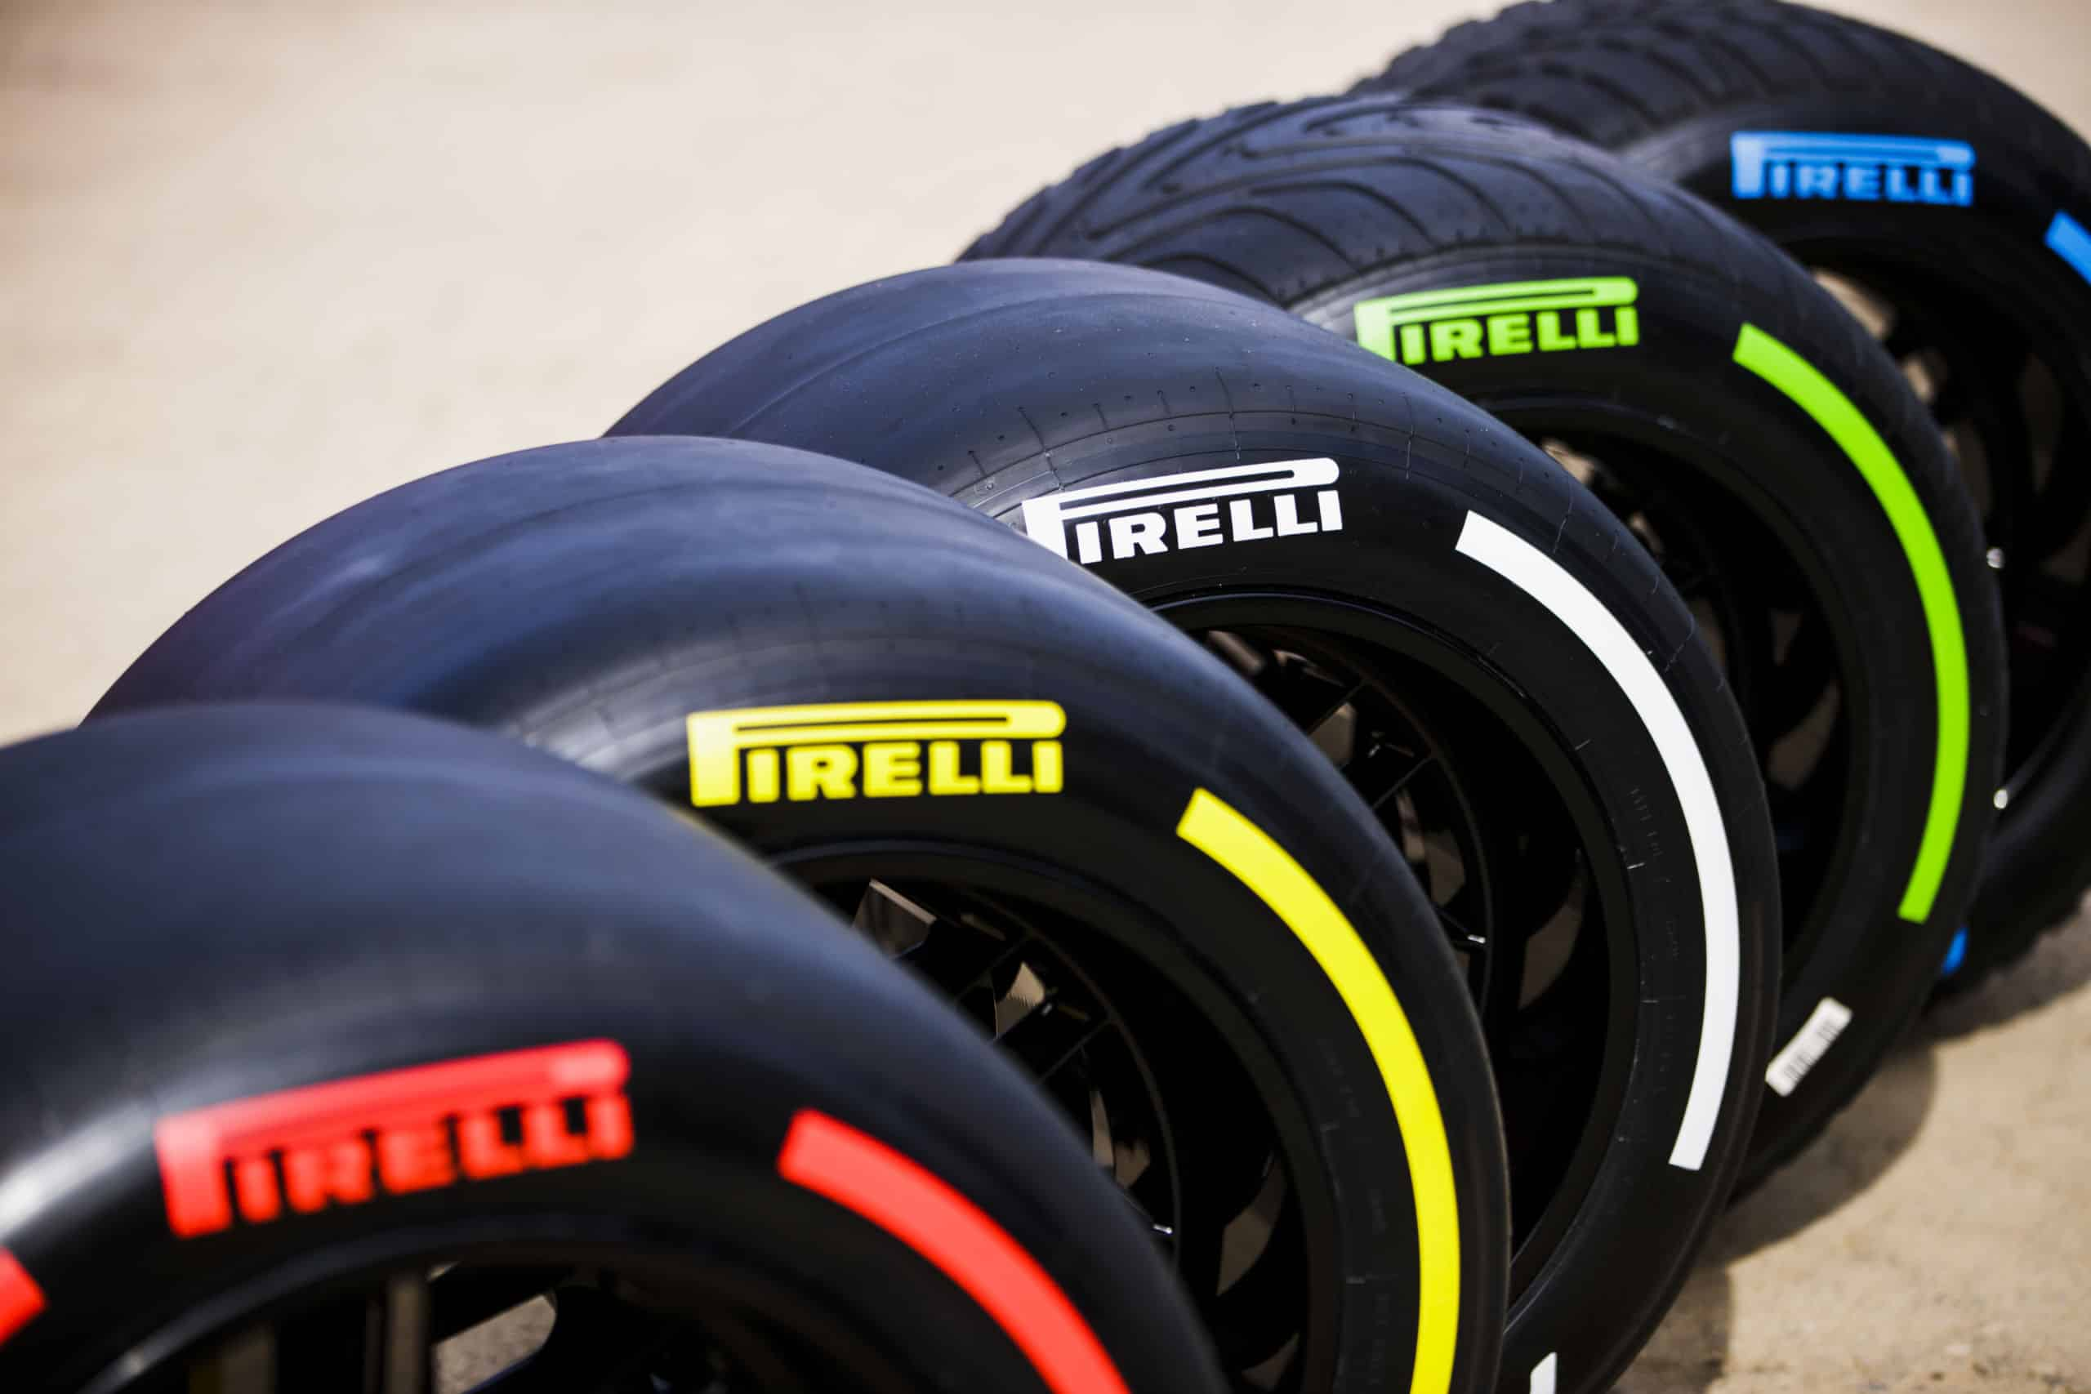

Our Goals
Collected weather, tire, telemetry, and pit stop data
Combined different data sets to make models more effective
Focused on developing a pit stop and tyre strategy to help teams like Red Bull (We Verstappen)
Notes:
Rohit- include why this presentation

Slide 4
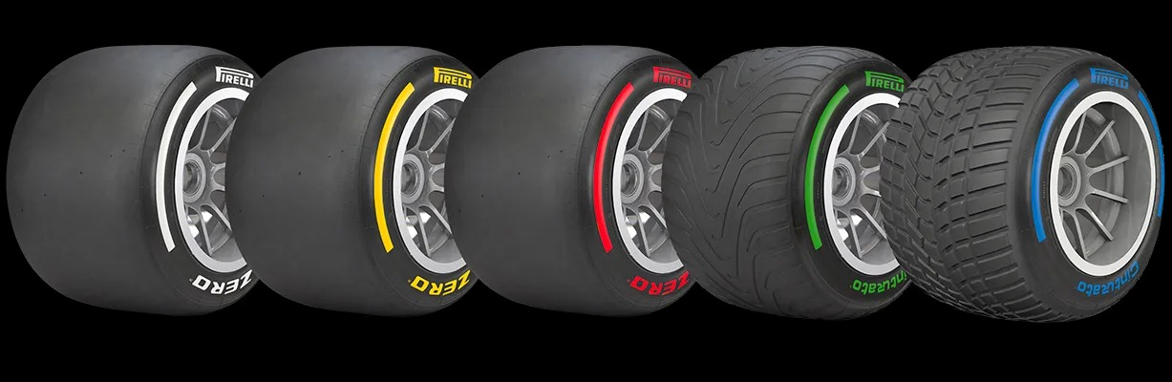
Data Collection & Data Cleaning – Tyre data
CFA F1 -> CSV -> Reordering
Data was reordered to align race winners sequentially
Notes:
Landon

Slide 5

Data Cleaning – Pit Stops
Checked for and dropped NaN values
Renamed unnecessary spaces in column names
Renamed Lap Stop to Lap to prevent confusion
Fixed rows with weird /xa0 value on the end
Added Winner & Type columns manually
Notes:
rohit

Slide 6

Data Pipeline
FastF1 API → Weather and telemetry data
Ergast API → Grand Prix metadata, Pit Stop data
F1CFA → Tyre data
Merge data → Preprocessing → Encoding/Standardization → Feature Engineering
Train-test split → Hyperparameter tuning → XGBoost training
Metrics → Visualizations (e.g., Confusion Matrix, Feature Importance)
Notes:
rohit

Slide 7
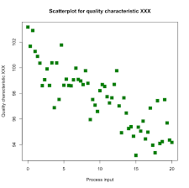
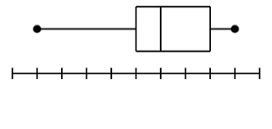
Exploratory Data Analysis – Pit Stops
Stratified by Circuit Type
Race Circuit
Street Circuit
Whole data frame
X > 25
Notes:
Keegan
Explain Race vs Street circuits
Race Circuit – A permanent track that is specifically built for F1 races
Street Circuit – A temporary track that is formed on regular city streets which are closed off for the races

Slide 8
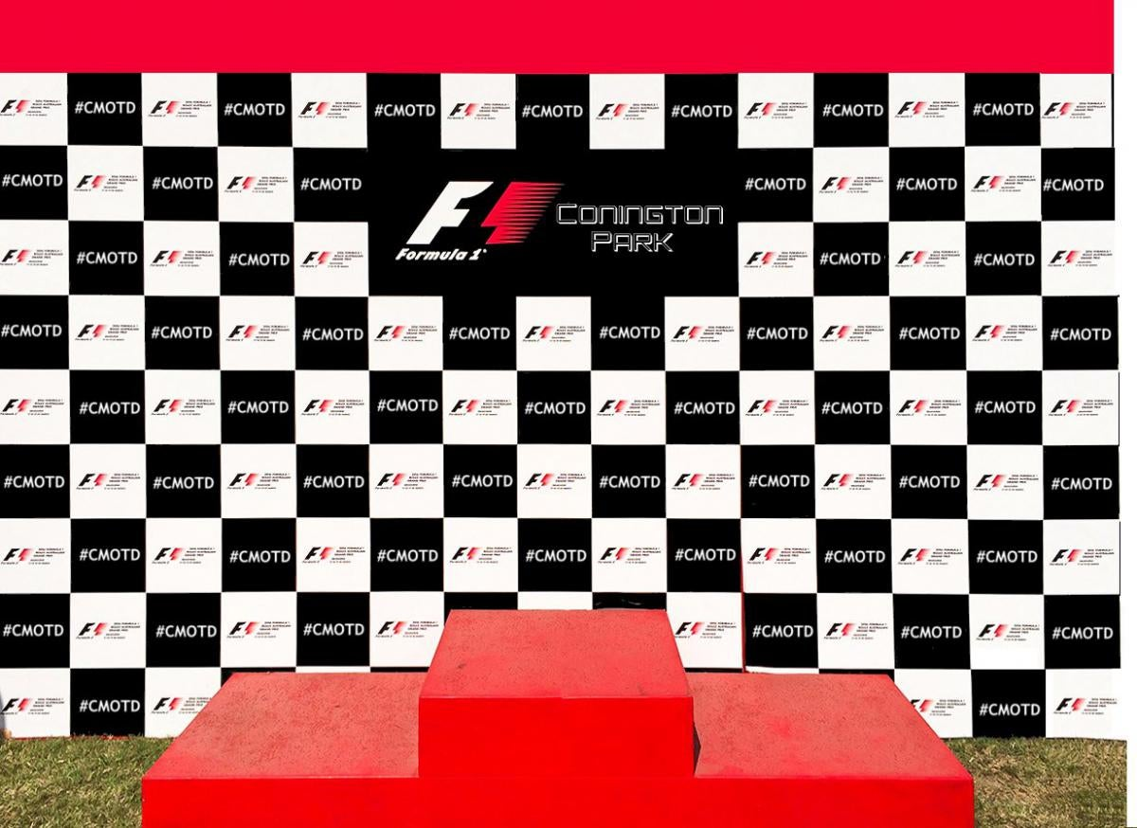
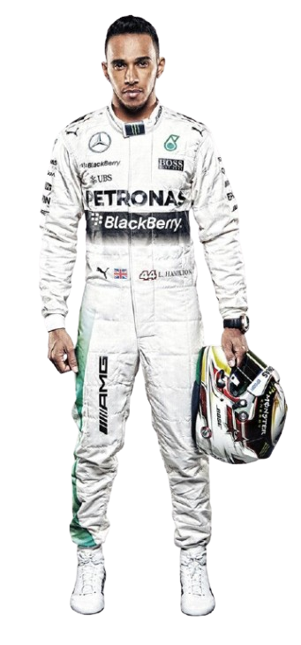
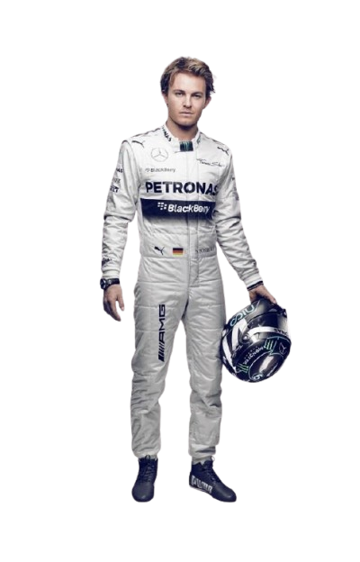
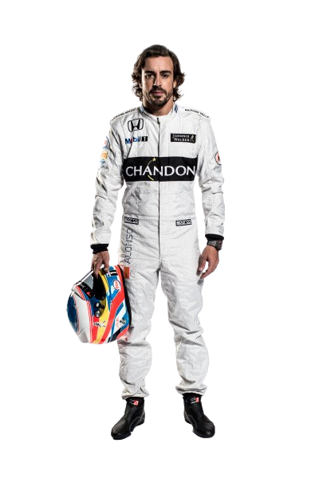
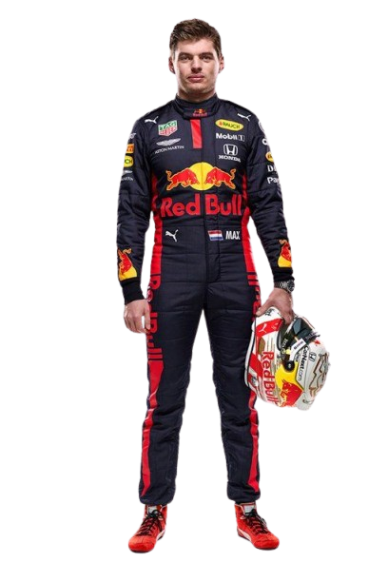
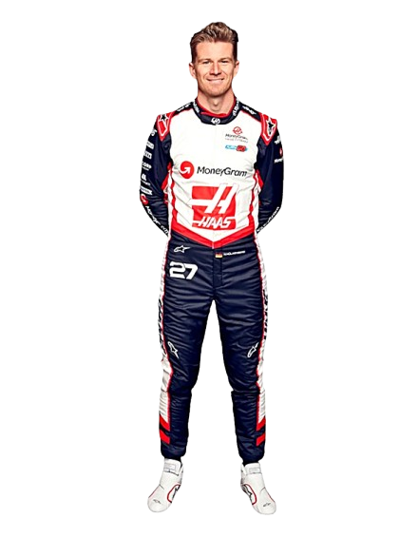
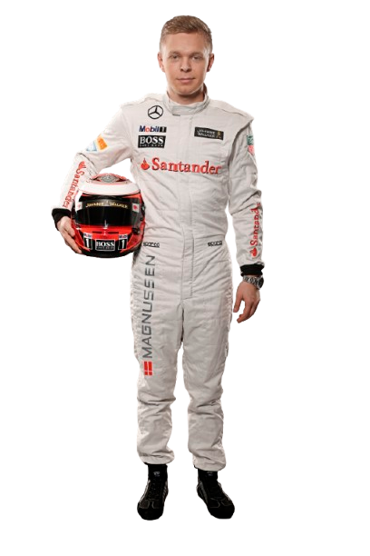

EDA - Separating Pit Stop Data
Separated Winners and Losers
Separated Best Three Winners and Worst Three Losers
Notes:
keegan

Slide 9
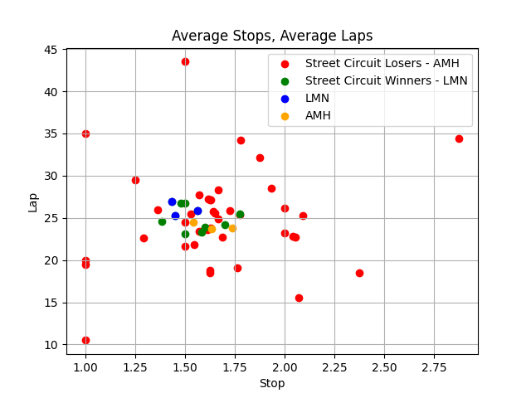
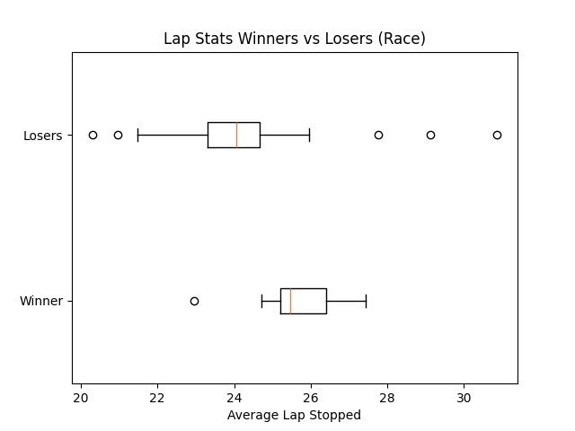
EDA – Pit Stop Graphs
On average winners pitted later than losers in race circuits, and the winner’s range is more condensed
Not a large difference but Nico Rosberg, Lewis Hamilton, and Max Verstappen are all around the same area
Notes:
keegan

Slide 10
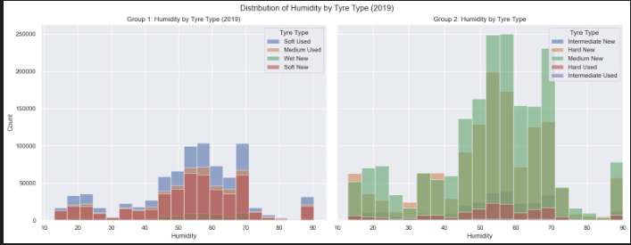
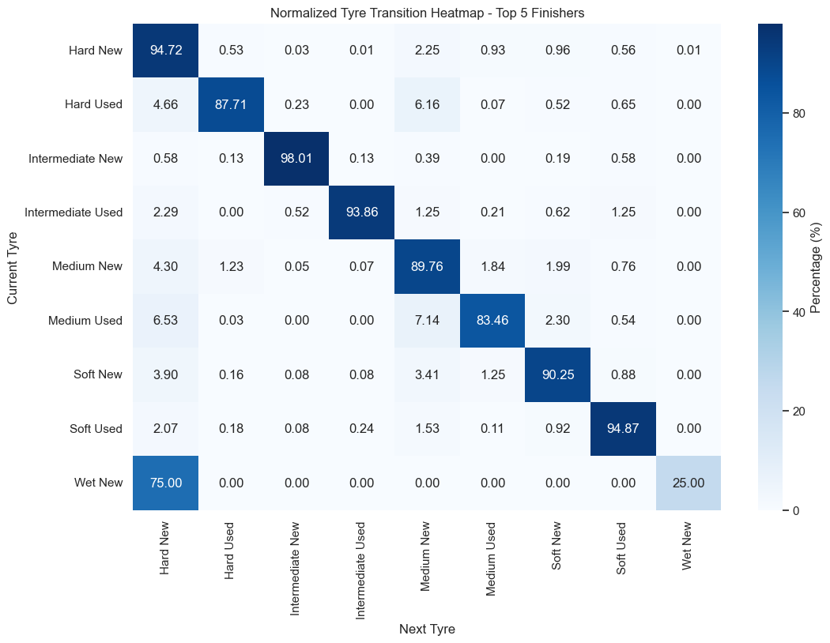
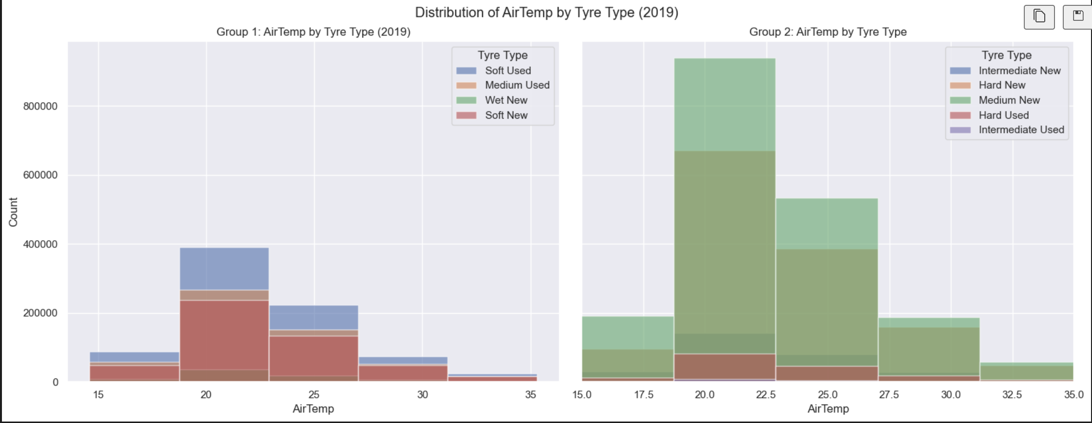
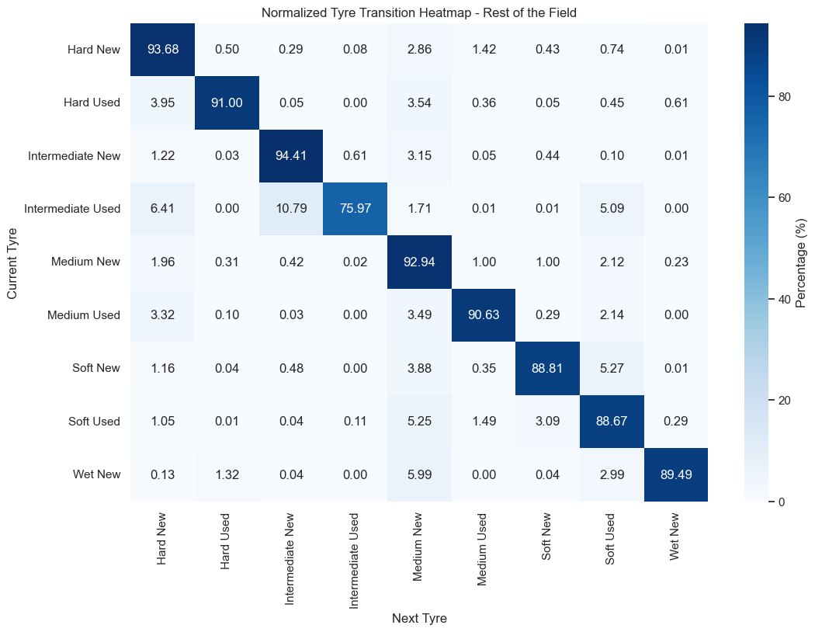
Weather/Tyre EDA
Notes:
landon

Slide 11
EDA – Weather / Tyre graphs (Humidity and tyre usage)
Tyre Popularity:
Soft Tyres and Medium New Tyres dominate across all humidity levels
Medium New Tyres are the most frequently used overall
Performance Insight:
Medium New Tyres sustain high speeds for a significant duration, making them an optimal choice for varied conditions
Notes:
Landon

Slide 12

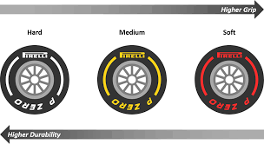
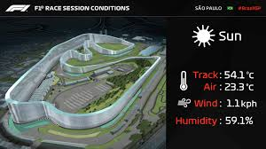
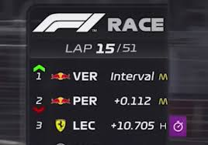
Exploratory Data Analysis – Weather/Tyre
Target variables
Analyzed a dataset containing 13 features and 9 target classes (Tyres)
AirTemp, TrackTemp, and Lap were biggest predictors
Notes:
Landon

Slide 13
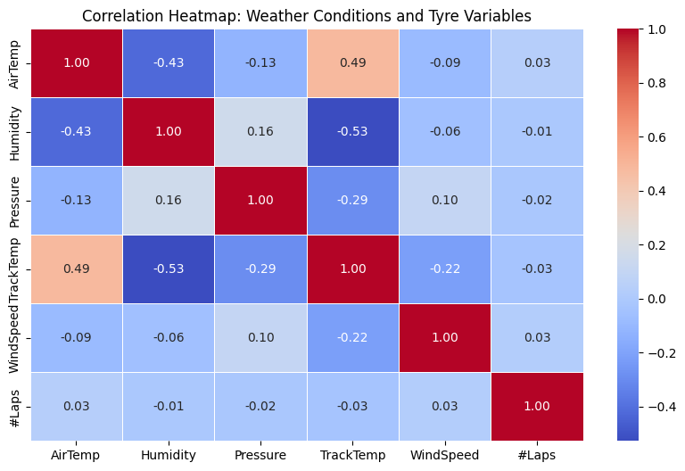
Data Transformation and Model Selection
Handled missing values using mean imputation for numerical features.
Encoded categorical variables (e.g., GP) using one-hot encoding.
Standardized numerical features (e.g., TrackTemp, Lap) using StandardScaler.
Transformed target variable (Tyres) into numeric labels for machine learning compatibility.
Evaluated multiple models (e.g., Decision Tree, Random Forest, SVM).
Selected XGBoost for its superior accuracy and ability to handle class imbalance effectively.
Notes:
Kirtan

Slide 14

Model Evaluation
Strengths
Limitations
High Feature Importance Insight: Key predictors like Speed and Throttle identified as critical contributors.
Interpretability: Random Forest provides easy-to-understand feature importances.
Low Prediction Error: Mean Squared Error (MSE) of 90.36 indicates reasonable accuracy.
Moderate Model Performance: R² Score suggests room for improvement in capturing variance.
Residual Clustering: Residual plot shows systematic patterns in prediction errors.
Overreliance on Key Features: High importance of Speed may indicate overfitting risks.

Slide 15
Results of Hyperparameter Tuning
Conducted 5 iterations with 3-fold cross-validation.

Slide 16
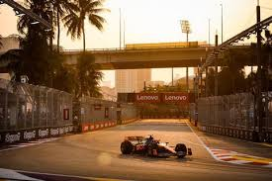
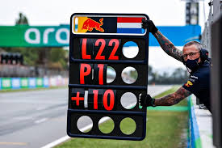
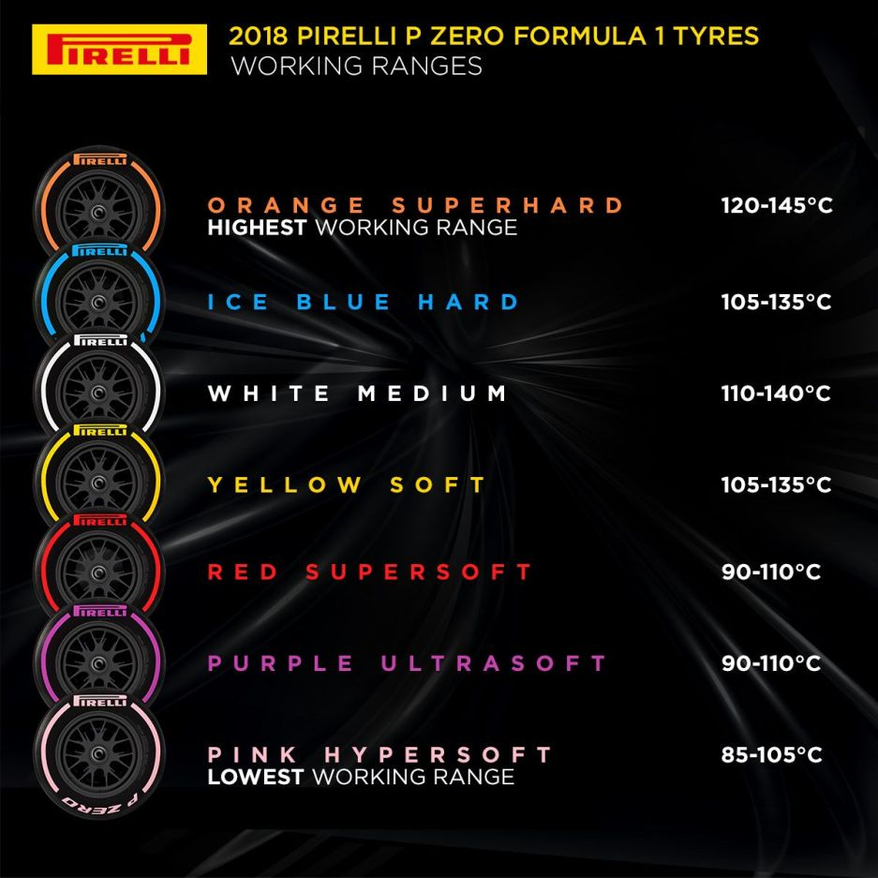

Key Drivers of Tyre Choice Predictions
Circuit-specific features (e.g., GP_Monaco) played a secondary role
Notes:
Humidity, lap, tire temp, air temp

Slide 17
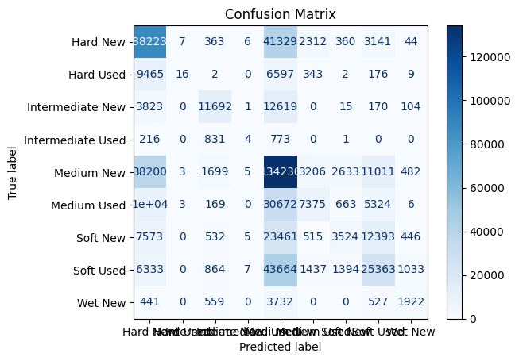
Model Accuracy and Limitations
The XGBoost model achieved an accuracy of 47.5%, indicating it captures some patterns but struggles with more complex interactions between variables
Frequent tyre categories like Hard New and Medium New were predicted with better accuracy
Rare tyre types such as Intermediate Used and Wet New showed poor performance, likely due to data imbalance
Notes:
kirtan

Slide 18
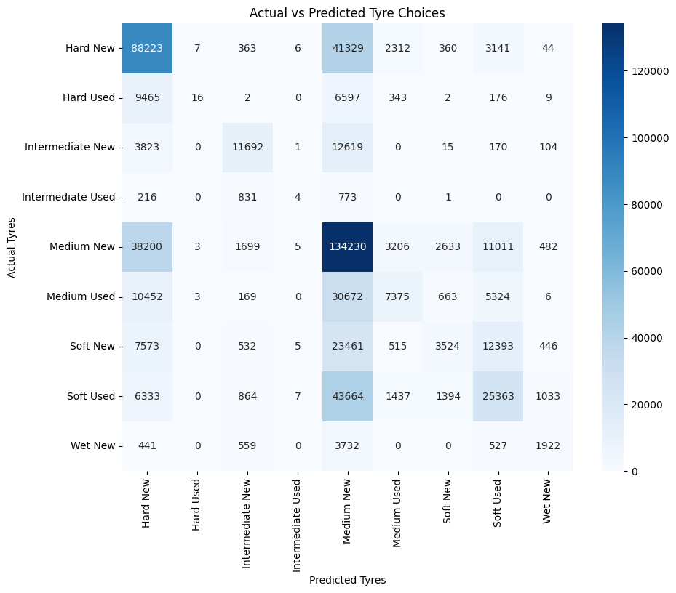
Trends in Predictions
The Actual vs Predicted Heatmap shows consistent misclassification patterns:
Hard Used tyres were often misclassified as Hard New
Medium Used and Soft Used were confused frequently, possibly due to overlapping characteristics or similar conditions
Notes:
kirtan

Slide 19
Model Usability
While the accuracy is moderate, the model provides actionable insights into tyre choices under specific weather and track conditions
This can serve as a baseline for further refinement, especially with richer features like pit strategy or driver preferences

Slide 20
Challenges and Next Steps
Data Imbalance: Rare tyre types significantly affect model performance; oversampling or synthetic data generation could improve predictions
Feature Expansion: Including additional variables like pit stops, safety car laps, or driver preferences might enhance predictive power
Advanced Techniques: Exploring ensemble models or neural networks could improve classification for edge cases

Slide 21
Data Analysis – Telemetry/Pitstops
Goal: Predict the Lap Stop feature for Formula 1 races using various features in the dataset, including Driver_x, RaceName, Speed, and telemetry data
Dataset: Formula 1 telemetry and pitstop data (merged_telemetry_and_pitstop.csv)
Model Used: Random Forest Regressor with 100 estimators
RMSE: 90.36
R² Score: 0.51

Slide 22
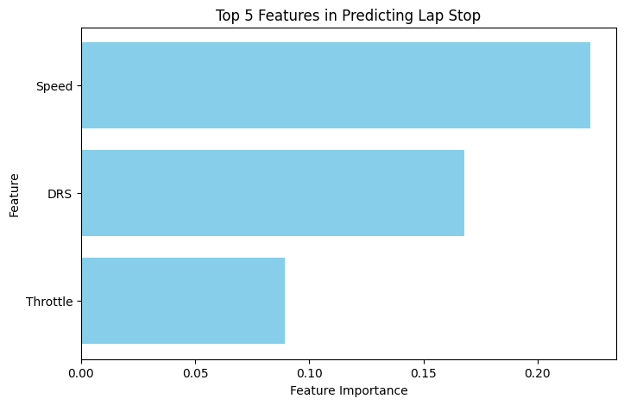
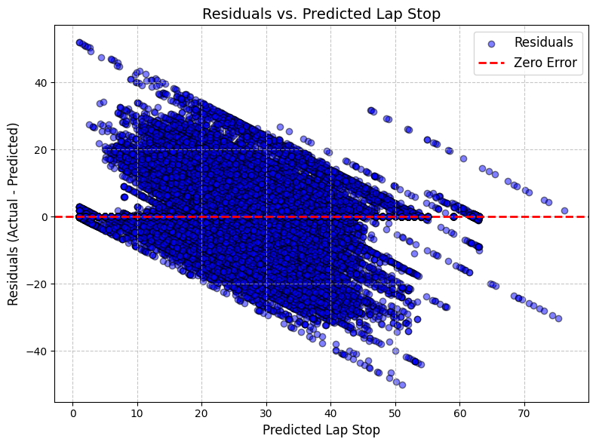
Interpreting Model Insights
Feature Importance Plot:
Identifies critical features contributing to predictions, led by Speed and Throttle
Indicates overtaking opportunities and driver strategy, indirectly affecting pit stop needs
Residual Plot:
Displays the distribution of prediction errors to evaluate model performance
Observed triangular spread suggests variability increases with higher predicted values (heteroscedasticity)

Slide 23
Model Optimization
Conduct hyperparameter tuning for the Random Forest model
Compare performance against other models
Consider adding interaction terms/engineering new features
Notes:
Landon
Conduct hyperparameter tuning for the Random Forest model to improve accuracy and reduce error
Compare performance against other models (e.g., Gradient Boosting Machines or Neural Networks) to ensure optimal results.
Consider adding interaction terms or engineering new features from the existing dataset
Like Speed × Throttle or Lap × TrackTemp to capture complex relationships.

Slide 24
What We Learned
Key Insights:
Weather variables (e.g., Humidity, TrackTemp) and Lap strongly influence tyre and pitstop strategies
Medium New tyres emerged as the most versatile option across various conditions
Model Evaluation:
Random Forest and XGBoost provided baseline models with moderate accuracy
Identified significant predictors, such as Speed and Throttle, but faced challenges with rare tyre types
Notes:
rohit

Slide 25

Things that went wrong/Had to fix
Lap data
Tyre
Lap data was updating every second
Extremely Large amounts of data
The tyre data was not effective without weather
Tyre naming system changed in 2019
Notes:
Rohit
Lap data
Lap data was adjusted to update every 1000 seconds
Extremely large amounts of data caused long waiting times for eda
Tyre
The tyre data was not effective without weather because weather influences tyre choices, so the datasets were merged
From 2019 onward, soft medium and hard names were used instead of ultrasoft, supersoft, etc.

